Slide 1



Laravel Lesson

Slide 2

What is Laravel?
is a free and open-source PHP web framework, created by Taylor Otwell and intended for the development of web applications following the model–view–controller (MVC) architectural pattern and based on Symfony

Slide 3
Why Laravel?
Extremely Secure
Simple Code Structure
MVC Architecture Support
Object-Oriented Libraries
Quick Development Time
Affordable

Slide 4
Salary
https://www.jobstreet.com.ph/laravel-developer-jobs?salary=60000&salary-max=2147483647
https://www.glassdoor.com/Salaries/laravel-php-developer-salary-SRCH_KO0,21.htm

Slide 5
Prerequisite
PHP
MVC
HTML and CSS
Composer
Apache Server or XAMPP

Slide 6
Common HTTP Methods
GET
POST
DELETE
PUT
PATCH

Slide 7
Database Migration
Running migration script
Creating migration table
Altering migration table
Creating factory
Creating seeder

Slide 8
Laravel Naming Convention
Model name should be singular, Pascal case
Controller singular Pascal Case
Table name should be snake case
functions or methods name are camelCase
Properties are camelCase
4 spaces must not use TABS
Parameter name should be camelCase
Resource: https://www.php-fig.org/psr/psr-12/
Note: PSR meaning PHP Standard Recommendation

Slide 9
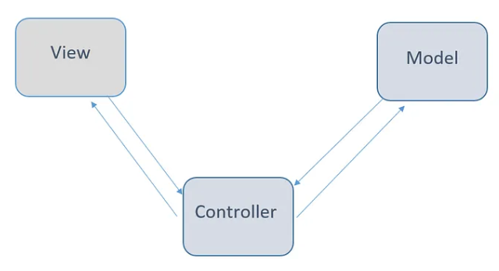
MVC
is a software design pattern commonly used for developing user interfaces that divides the related program logic into three interconnected elements. This is done to separate internal representations of information from the ways information is presented to and accepted from the user.

Slide 10
Process of Creating MVC
Route to Controller
Controller to Model
Controller to View
Repository Pattern -> this is optional

Slide 11
Controller
//

Slide 12
Model
//

Slide 13
View
//

Slide 14
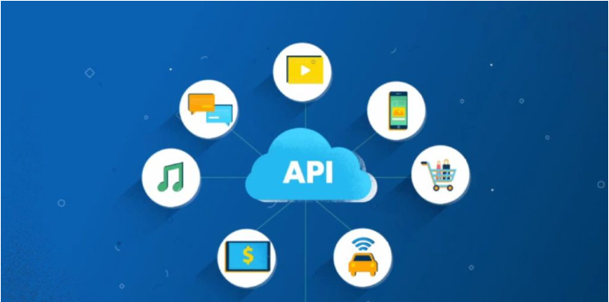
What is API?
Stands for Appication Programming Interface is a way for two or more computer programs to communicate with each other.

Slide 15
What is Rest API?
is an application programming interface (API or web API) that conforms to the constraints of REST architectural style and allows for interaction with RESTful web services. REST stands for representational state transfer and was created by computer scientist Roy Fielding.

Slide 16
Web Service vs Web Page?
A webpage is a part of a website; it means a website contains different web pages
A web service, a web technology such as HTTP is used for transferring machine-readable file formats such as XML and JSON

Slide 17
Postman Installation
https://www.postman.com/

